Slide 1
Cell membrane

Slide 2
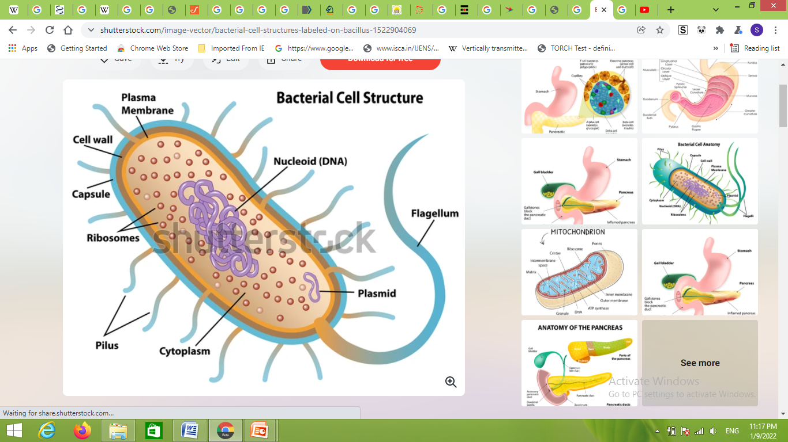
Structure and chemical composition

Slide 3
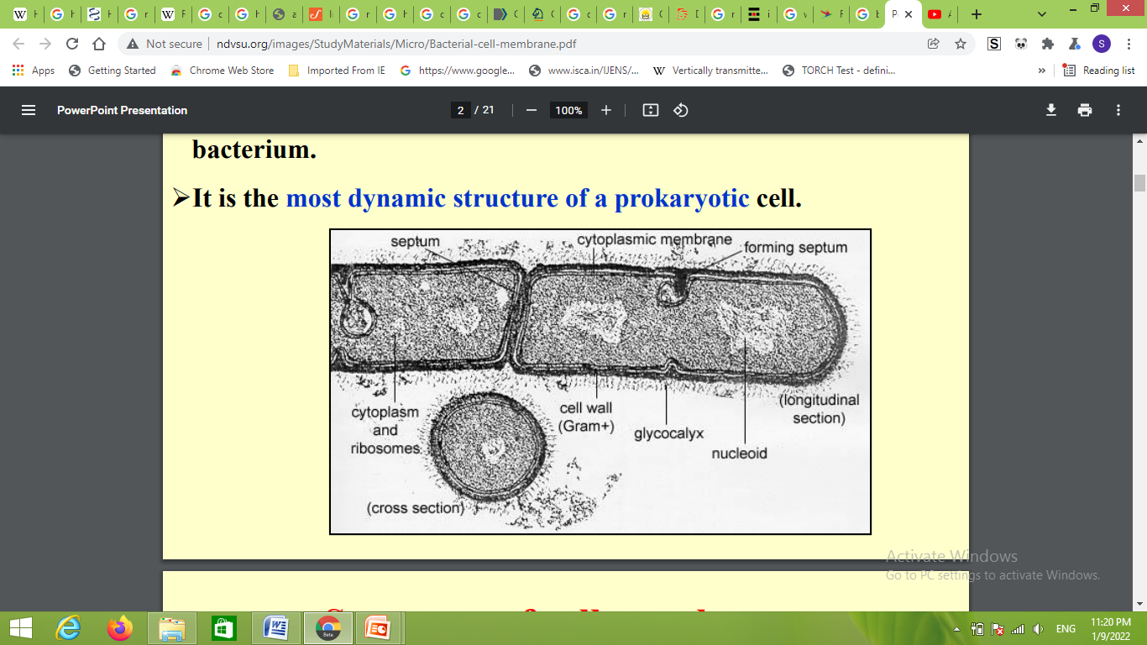
Structure and chemical composition

Slide 4
Cell membrane
The cytoplasmic membrane also called cell membrane or plasma membrane, is about 7 nanometer thick.
It lies internal to the cell wall and encloses the cytoplasm of the bacterium.
It is the most dynamic structure of a prokaryotic cell.

Slide 5
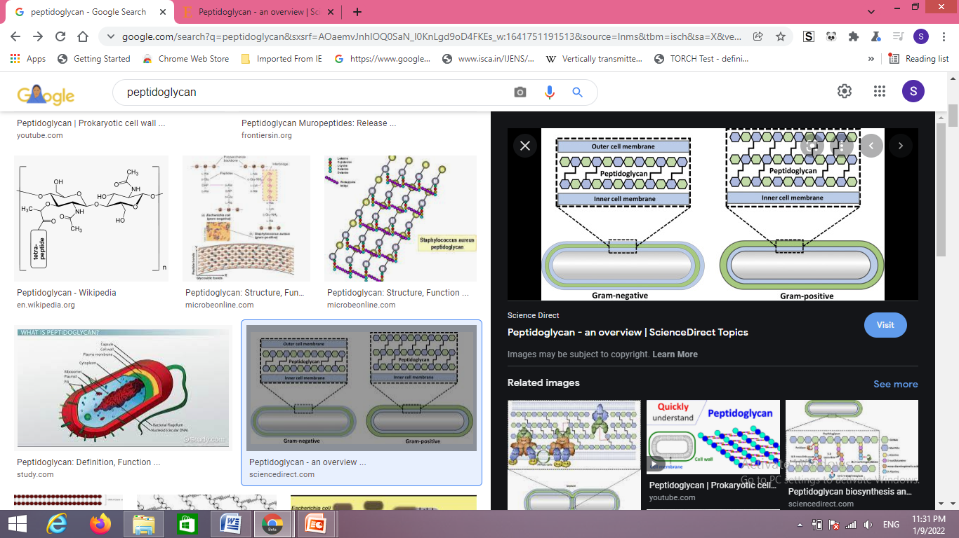
Peptidoglycan
For eubacteria, the shape determining part of the cell wall is largely peptidoglycan (murein), an insoluble porous, cross-linked polymer of enormous strength and rigidity.
Found only in prokaryotes in the form of ‘’bag-shaped macromolecules” surrounding the cytoplasmic membrane.
Peptidoglycan is basically a polymer of N-acetylglucosamine, N-acetylmuramic acid, L-alanine, D-alanine, D-glutamate and a diamino acid.
Peptidoglycan is tough and in order to grow and divide, portion of the peptidoglycan must contibually be degraded by wall-associated hydrolytic enzymes so that new polymer can be added

Slide 6
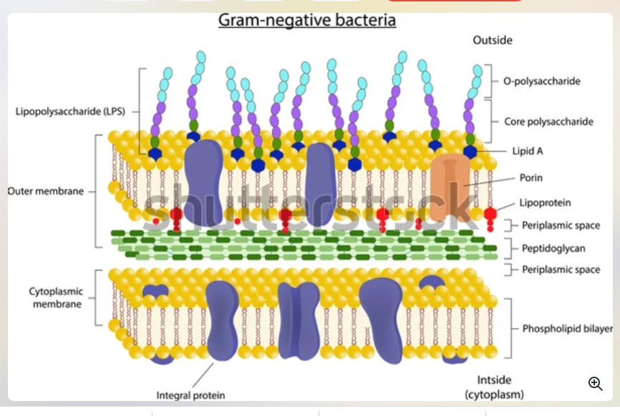

Slide 7
CYTOPLASMIC MEMBRANE
COMPOSED OF-
1Phospholipids ( 20 to 30 %)
2. Proteins ( 60 to 70%)
phopholipids= forms bilayer in most of proteins are present. If proteins are present within phospholipid bilayer or proteins are tenaciously held are integral proteins……….
Proteins are present outside ……pheripheral proteins

Slide 8
Remove proteins from phospholipids bilayer?????
Destruction of phospholipid bilayer of plasma membrane/cellmembrane / cytoplasmic membrane??
By using detergents SDS, Using some treatment such as osmotic shock, mild treatment ….
Cytoplasm, fluid like structure….contains lipids matrix of membrane …….
Why this fluid ….. Various membrane function and depend on various factors like temperature,

Slide 9
Function of cytoplasmic membrane/ cell membrane/ Plasma membrane.
Hydrophobic barrier to penetration of water-soluble molecules.
Specific proteins (Integral proteins, peripheral proteins) allow, passage of small molecules (like the nutrients and waste products).
Contains various enzymes involve in respiration metabolism, synthesis of cell wall component, impermeability to protons (Hydrogen ions), generation of proton-motive force (ATP), Nutrient transport, and flagellar motility

Slide 10
Conti…..
Cytoplasmic membrane/ cell membrane…… important for functional structure and damage (physical or chemical).
Hydrophobic barrier?????
Porins or lipopolysaccaride.
Extracelluar Genenzymes…gene??? gene code for proteins carry message …..

